Slide 1
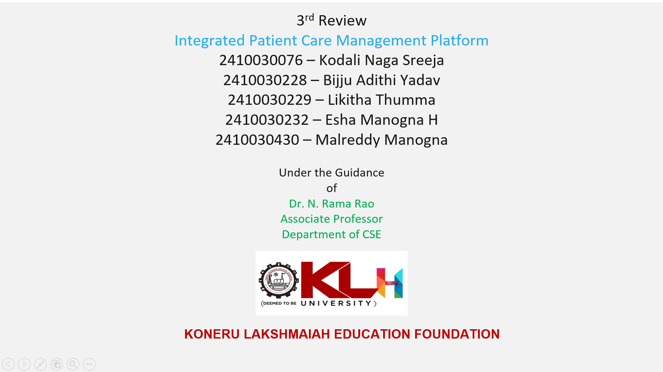
4th

Slide 2

Recap:
Objective: To develop a web-based platform that integrates hospital activities — including patient registration, appointments, billing, and medical records — into one centralized system.
Key Features:
Digital storage of patient details
Doctor scheduling and appointment booking
Automated billing and report generation
Role-based login (Admin, Doctor, Receptionist)

Slide 3
System Modules:
Patient Information Management
Doctor and Employee Management
Room and Equipment Allocation
Medicine and Billing Management
Record Maintenance and Tracking

Slide 4
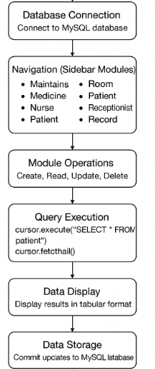
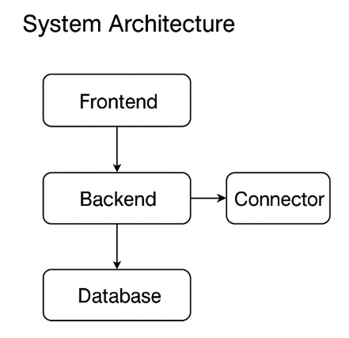
Workflow
System Architecture

Slide 5
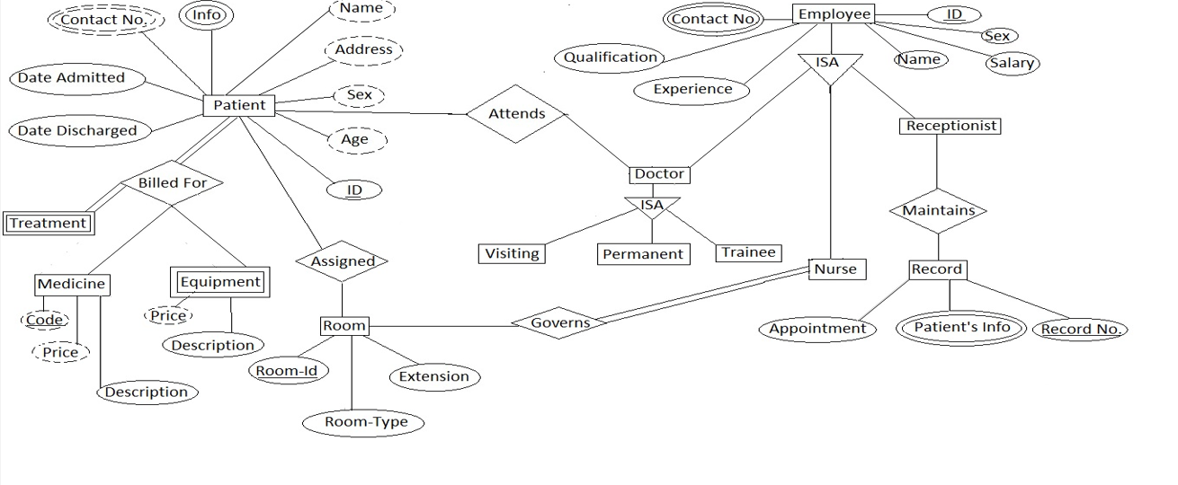
ER Diagram

Slide 6
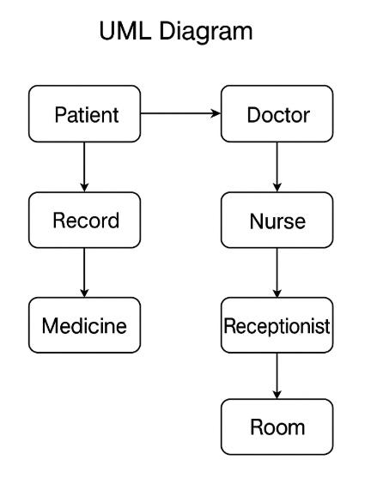
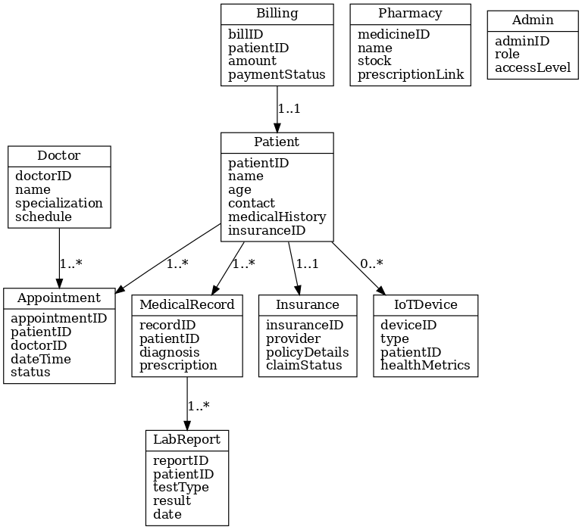
Class Diagram
UML Diagram

Slide 7
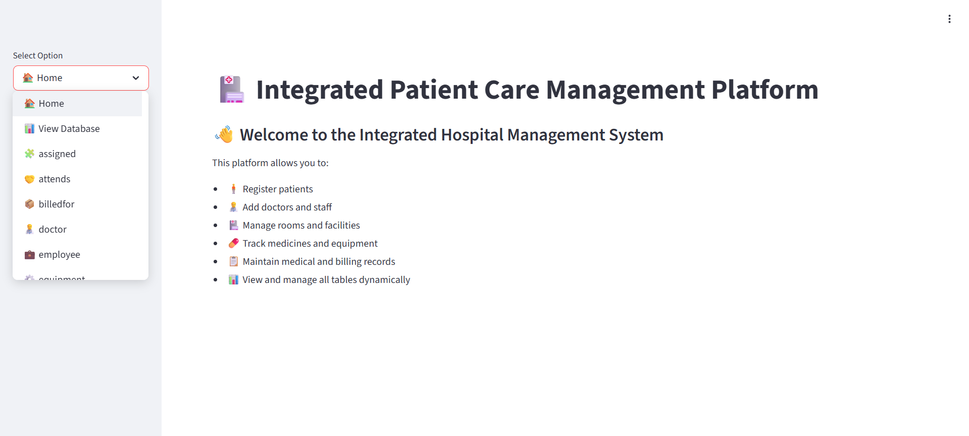
Output

Slide 8
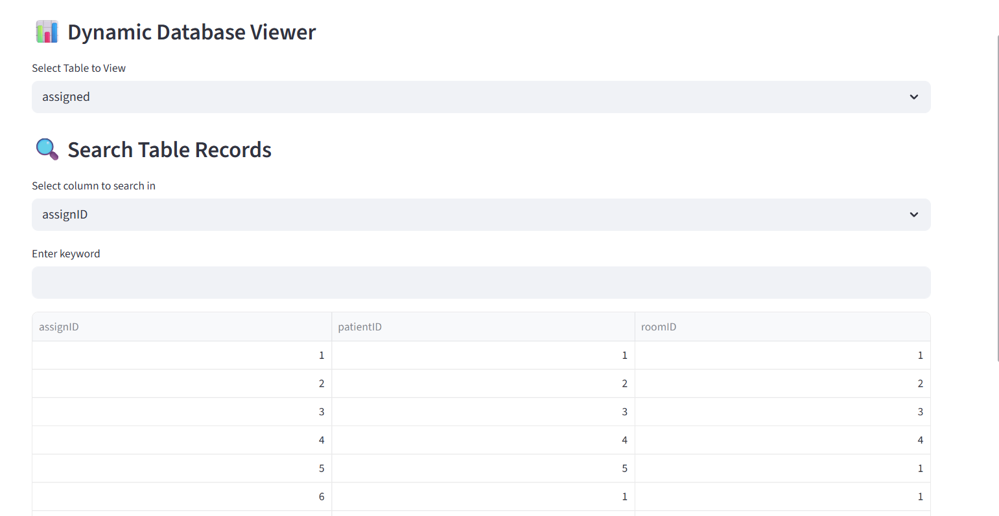

Slide 9
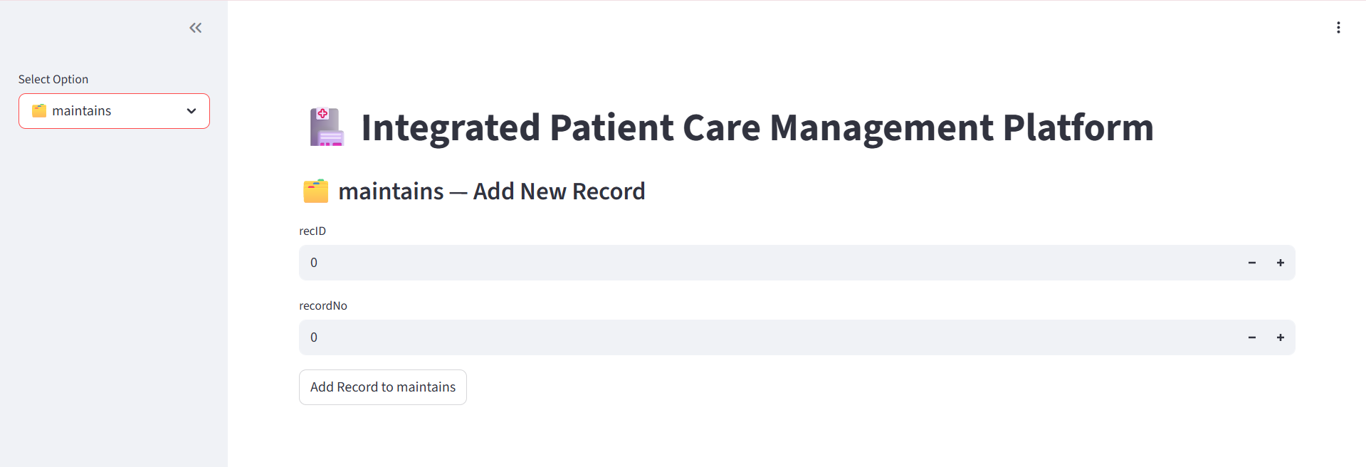

Slide 10


